Slide 1
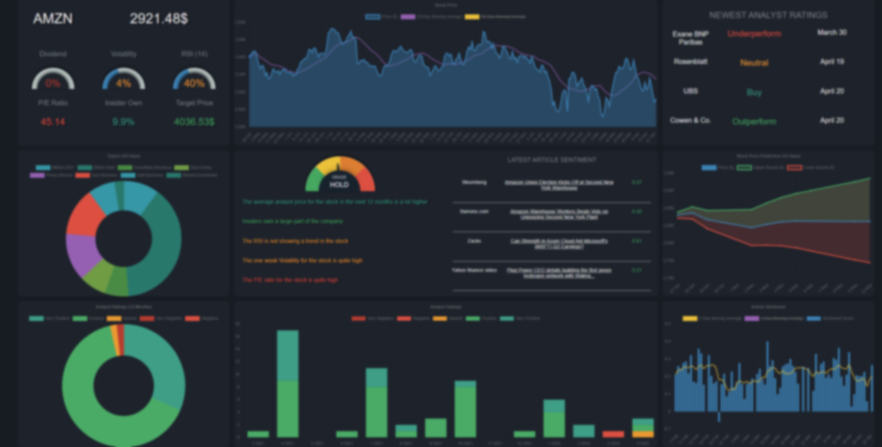
Financial Stock Dashboard
Andris Vaivods

Slide 2
Summary
Financial stock Dashboard where the user can view various metrics about the stock
Stock Screener where the user can filter and search for specific stocks
MongoDB Atlas Cloud database
Backend Python code
Sentiment Analysis
Topic Extraction
Predictive Modelling
Web Scraping
Data Cleaning

Slide 3



Motivation
Passion for Investing and Data analysis
Alternative to Expensive Software
The Dashboard form is a great fit for the average investor
Developing the right skills
Improve existing websites

Slide 4
Aims and Objectives
Help the user make future investment decisions
Provide accurate and helpful information related to the stock
Allow the user to search and compare different stocks
Provide points for further research
Create a website that is useful for new and experienced investors
Perform user testing to make the website as user friendly as possible
Create a website that can be used as a learning resource
Write code that is reliable
Test the code through unit testing
Create a database that is scalable
Allow for the database to store information about hundreds of stocks
Create a database that allows for quick queries
Write code that can be automated
Present the information in visually pleasing way
Write can that can efficiently run on home hardware

Slide 5
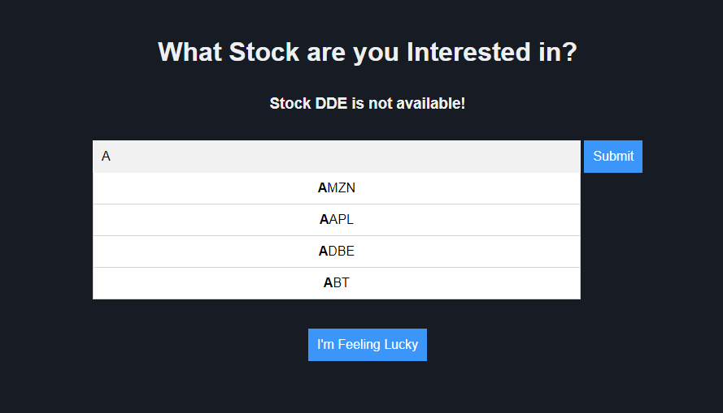

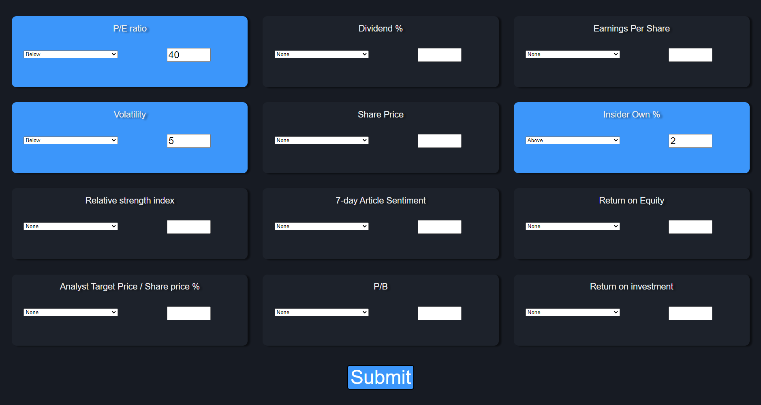
Frontend
Landing Page / Search Page
Dashboard
Stock Screener

Slide 6



Creating the frontend
Setup a NodeJS server to access the database
Use ExpressJS to send the data to the users website
Use HTML, CSS and JavaScript to create the layout and design
Send API requests to access the data
Use Chart JS to create visually pleasing graphics

Slide 7

The Dashboard
Fundamental metrics
Historic stock price and Moving averages
Newest Analyst Ratings
Topics from articles
Textual summary
Latest articles and sentiment
Stock Price predictions
Historic analyst ratings
Historic Sentiment and Moving Averages

Slide 8
The Stock Screener
Filter by twelve different metrics
Pick from one of the three presets
Order results by specific metric
View Dashboards

Slide 9
Demo

Slide 10
Backend
Web Scraping
Data Cleaning
Sentiment Analysis
Topic Extraction
Predictive Modelling
Database

Slide 11
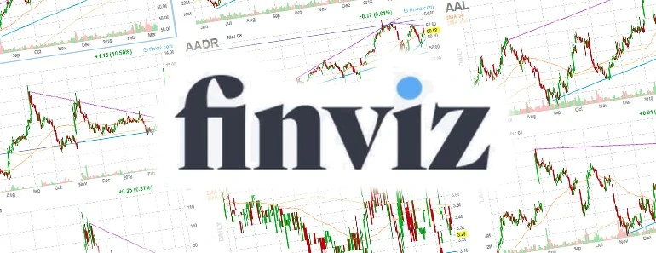


Web Scraping
Extract article links and stock metrics from FINVIZ.com
Open each article using Requests and extract the HTML
Check if article is about the specific stock
Clean HTML with BeautifulSoup
Use the Yahoo finance API to get analyst ratings and historic price
Store all the information in Pandas Data frames

Slide 12


Data Cleaning
Remove unnecessary whitespace
Remove characters that do not effect sentiment.
Now the text is ready for Sentiment analysis
Remove stop words like “the”, “she”, “have”
Remove often mentioned words like “stock” and “company”
Remove all punctuation
Perform lemmatization
Lowercase all text

Slide 13
Sentiment Analysis
Tokenize text into sentences
Remove last three sentences from articles
Analyse the sentiment of the title and text using VADER
Each article is assigned a compound score from -1 to 1
Split the data into one day sections
Generate Moving averages for daily sentiment

Slide 14
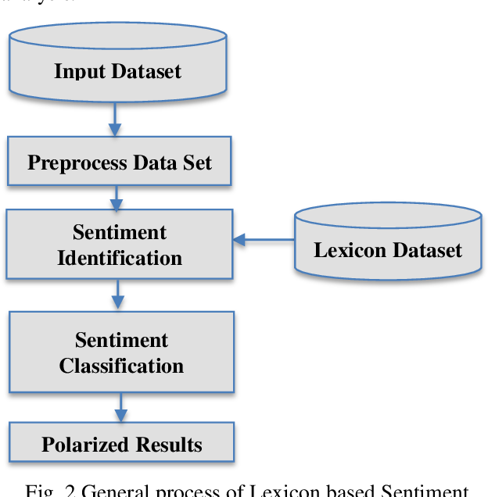
Vader
Valence Aware Dictionary and sEntiment Reasoner
Lexicon and rule-based
Does not require any training data

Slide 15

Topic Extraction
Gather articles in the last 14 days
Create term dictionary
Convert articles into a term matrix
Pass the term dictionary and term matrix through the GENSIM Latent Dirichlet Allocation (LDA) model.
Generate 8 topics with two words in each topic

Slide 16
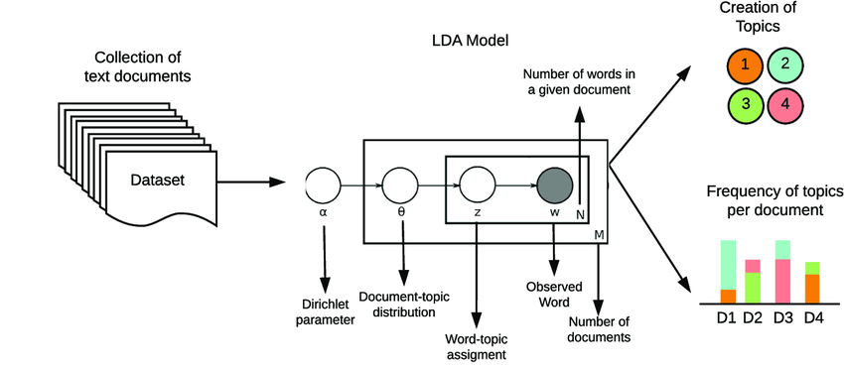
Latent Dirichlet Allocation (LDA)
Each word in each document is randomly assigned to one of the ‘T’ topics.
Assume that all topic assignments except for the current one are correct.
The proportion of words in the document, ‘d’ that are currently assigned to topic ‘t’ is equal to p(topic t | document d), and the proportion of assignments topic ‘t’ over all documents that belong to word ‘w’ is equal to p(word w | topic t).
These two proportions are multiplied and assigned a new topic based on that probability.

Slide 17


Predictive Modelling
Use historic price to predict future price
Predict the price for the next two weeks using an LSTM model
Long short-term memory (LSTM) is an artificial neural network
Can process sequences of data
Fit the model with price in the last ten years
Use drop gates to avoid overfitting
Use the previous 50 days to predict the next day

Slide 18


Database
MongoDB Atlas Cloud database
Stored in JSON format
13 collections in total
50 different stocks
Over ten thousand articles

Slide 19
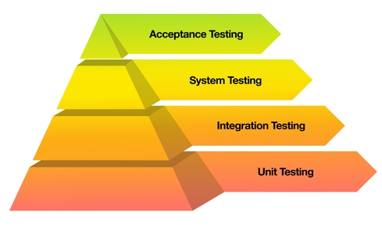
Testing
The goal of testing the back-end was to make sure that the code was ready to be automated
Create Unit tests to test the backend Python code
Each function is a unit
The Objective of testing the front-end was to make sure that the user experience was as good as possible
Perform user testing and acceptance testing by getting feedback from potential users

Slide 20
Challenges
Create a dashboard that is visually pleasing
Get feedback from potential users
Learn the new tools like ChartJS and NodeJS
Took online courses and watched YouTube videos
Use Sentiment to Predict Future Price
Decided not to use sentiment since I couldn’t acquire enough data
Extract valuable topics from articles
Used a set of frequently occurring words to remove

Slide 21
Conclusion
The website’s goal was to have a dashboard that the user could use to make future investing decisions
Accomplished this task and added additional features that could further improve the website’s usability, such as the stock screener and tooltips for new investors
The back-end code is efficient; topics extracted are relevant to the stock and can be used as points for further research
Generated sentiment scores are accurate and helpful
Even though the website is ready for public use and could be launched, there is still room for future improvements

Slide 22

Thank You! Any Questions?

